Slide 1
DISTRICT 216
ALIGNMENT PROPOSAL

Slide 2
District 216 Alignment Proposal — Executive Summary Purpose This proposal presents a realignment of District 216 clubs into Divisions and Areas in accordance with Protocol 7.0, ensuring each Area contains 4–6 clubs capable of effective support and sustainable performance. Guiding Principles Club assignments were determined using the following criteria: Geographic proximity of clubs Ability of Area Directors to provide effective service Club size, strength, and stability Anticipated growth and prospective clubs Eligibility for Distinguished recognition at the Area and Division levels Proposed Structure District 216 is organized into 5 Divisions (A–E) Divisions are composed of Areas 1–25, each meeting Protocol requirements All known clubs within the District are assigned to an Area Governance & Oversight The alignment was developed by the District 216 Alignment Committee, composed of experienced leaders currently serving Districts 11,28 & 62. Outcome This alignment improves service coverage, supports club success, and positions District 216 for operational effectiveness and Distinguished performance in the upcoming program year.

Slide 3
Protocol 7.0: District Structure
1. Club Assignments
Areas consist of four (4) to six (6) clubs as of July 1, of which a minimum of four (4) must be in good standing.
4. District Realignment
The realignment of a District occurs on the initiative of the Board.

Slide 4
Districts assign clubs to Areas based upon:
Geographic proximity to other clubs
The ability of an Area Director to effectively provide service, without requiring the clubs to change how meetings are conducted to accommodate an Area Director visit
Club size and strength (e.g., paid, active, disbanding)
Prospective clubs and expected growth
The likelihood of eligibility for Distinguished programs (e.g., club base of the Area or Division)

Slide 5
District 216 Alignment Committee Members Currently Serving Your District
Dawn McCory Div. A
Tracy Gibson Div. E
Dvid Trottier Div. N
Fred Lewis Div. O
Joel Toussaint Div. W
Mike Carter PDD
Committee Chair
Pamela Sheffey Div. C
Merek Roman Div. N
Chris Harwood Div. S
District 11
District 28
District 62

Slide 6
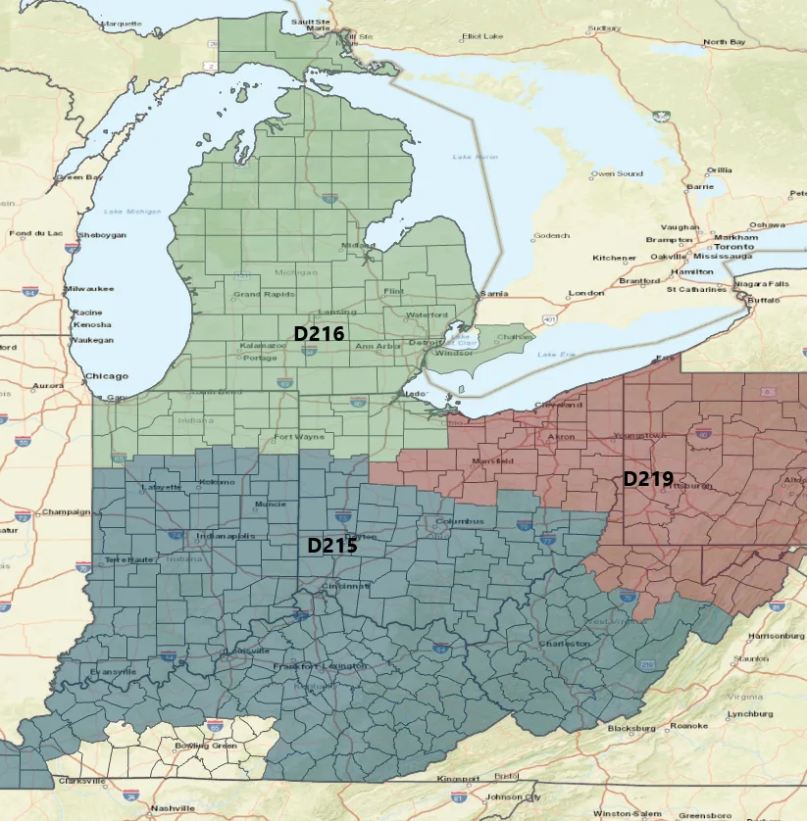
Regions 1-7 Group 10:
Current Districts
10, 11, 13, 28, 40, and 62

Slide 7
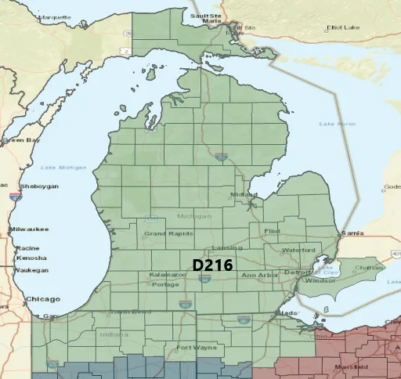
District 216:

Slide 8
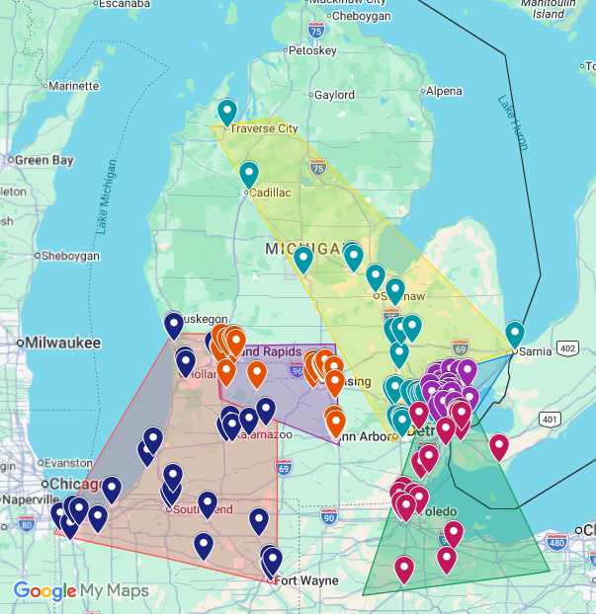
District 216 By Division:
Division A
Division B
Division C
Division D
Division E

Slide 9
DIVISION A Area 1
Area | Club # | Club Name
1 | 3313 | Calumet Toastmasters Club
1 | 6116530 | Lake Effect Toastmasters Club
1 | 5499945 | Online TLC Toastmasters
1 | 7269291 | Singing Sands Toastmasters Club
1 | 4742 | The Great Communicators of NW Indiana
1 | 255 | Valparaiso Club

Slide 10
DIVISION A Area 2
Area | Club # | Club Name
2 | 9117 | Four Flags Club
2 | 9642 | Maple City Toastmasters Club
2 | 3646738 | Notre Dame Toastmasters
2 | 394 | Tuesday Night Toastmasters
2 | 1410 | Twin City Toastmasters, Club #1410
2 | 202 | Whirlpool Toastmasters

Slide 11
DIVISION A Area 3
Area | Club # | Club Name
3 | 521 | Anthony Wayne Toastmasters Club
3 | 666 | Bob Leiman Toastmasters Club
3 | 610356 | Brotherhood Mutual's Club
3 | 4077249 | Four Score and Seven Speeches Ago
3 | 4845 | Lunchtime Speaking To Succeed Club
3 | 7194005 | Zimmer Biomet Toastmasters

Slide 12
DIVISION A Area 4
Area | Club # | Club Name
4 | 3599862 | Grandville-Jenison Chamber Toastmasters
4 | 8791 | Haworth/Holland Toastmasters Club
4 | 6186 | Lakeshore Club
4 | 3766 | Macatawa Club
4 | 9371 | Tri-City Club

Slide 13
DIVISION A Area 5
Area | Club # | Club Name
5 | 3475612 | Galesburg Toastmasters
5 | 1270 | Kalamazoo Club
5 | 2050 | Logistics Center Toastmasters Club
5 | 7886167 | Southwest Advanced Toastmasters
5 | 2561556 | Stryker Toastmasters
5 | 4779295 | Zoetis Toastmasters

Slide 14
DIVISION B Area 6
Area | Club # | Club Name
6 | 3309 | BDO Club
6 | 6937 | GFS Food For Thought Club
6 | 3637 | Gun Lake Toastmasters
6 | 791395 | Mutual Toasters Club
6 | 28675968 | Remarkable Results Toastmasters

Slide 15
DIVISION B Area 7
Area | Club # | Club Name
7 | 28677038 | CU*Toastmasters
7 | 8177 | GVSU Downtown Club
7 | 404 | Grand Rapids Toastmasters
7 | 6187 | Lunch Bunch Club
7 | 6180 | West Michigan Advanced Toastmasters

Slide 16
DIVISION B Area 8
Area | Club # | Club Name
8 | 6415 | Auto-Owners Club
8 | 4873156 | Lansing Lucidas
8 | 28677148 | Michigan State Police Speakers Guild
8 | 3941741 | Regulatory Ramblers
8 | 2714 | Secondary To None Club
8 | 2345 | Toastnotables Toastmasters Club

Slide 17
DIVISION B Area 9
Area | Club # | Club Name
9 | 5799 | C Division Advanced Speakers 5799
9 | 639 | Capital City Toastmasters
9 | 28678363 | Dart Bank Toastmasters
9 | 7307 | Eloquents
9 | 811867 | Talk of the Town Club
9 | 4776 | Transportation Club

Slide 18
DIVISION B Area 10
Area | Club # | Club Name
10 | 1572737 | Rising Stars Toastmasters Club
10 | 3306 | Yawn Patrol Toastmasters
10 | 1080 | Power Toastmasters Club
10 | 28675676 | NPG Toastmasters
10 | 3917 | Trailblazers

Slide 19
DIVISION C Area 11
Area | Club # | Club Name
11 | 6563 | Ann Arbor Toastmasters And Friends Club
11 | 1909 | Huron Valley Toastmasters Club
11 | 1142257 | Insights Toastmasters of Brighton Michigan
11 | 7832 | NSF Toastmasters Club
11 | 3054 | Washtenaw Toastmasters Club

Slide 20
DIVISION B Area 12
Area | Club # | Club Name
12 | 1995 | Cadillac Area Toastmasters Club
12 | 5116 | Cherry Capital Club
12 | 2399 | Midland Club
12 | 781 | Saginaw Harvey Spaulding Toastmasters Club
12 | 5652 | Tuesday Talkers Toastmasters Club

Slide 21
DIVISION B Area 13
Area | Club # | Club Name
13 | 28678292 | Central Michigan University
13 | 699671 | Fenton Area Toastmasters Club
13 | 1267736 | Frankenmuth Toastmasters
13 | 5470 | Genesee Toastmasters
13 | 1323949 | Greater Davison Area Toastmasters Club
13 | 2826 | Greater Flint Toastmasters Club
13 | 1021 | Hi-Noon Toastmasters Club 1021

Slide 22
DIVISION B Area 14
Area | Club # | Club Name
14 | 8085 | Ford Toastmasters Club
14 | 3481227 | Forefront Toastmasters Club
14 | 1660 | Motor City Speak Easy Toastmasters Club
14 | 6556 | Saturday Sunrisers Club
14 | 1535 | The Wind Baggers Club
14 | 1142333 | Westside Professionals

Slide 23
DIVISION C Area 15
Area | Club # | Club Name
15 | 3939904 | Cengage Toastmasters
15 | 7859371 | ITC Powered Communicators
15 | 28677540 | Lake Trust Toastmasters
15 | 3733 | Novi Toastmasters Club
15 | 28677780 | Pratt Miller Toastmasters
15 | 7721041 | TBATC Toastmasters

Slide 24
DIVISION D Area 16
Area | Club # | Club Name
16 | 957 | Birmingham Club
16 | 28677492 | Legacy Speaks
16 | 4890 | Rochester Toastmasters Club
16 | 7897431 | STAAND Toastmasters
16 | 1152252 | TMZ - Toast Masters Zone At WMBC
16 | 7955644 | Taubman Toastmasters

Slide 25
DIVISION D Area 17
Area | Club # | Club Name
17 | 1196053 | Confident Communicators Club
17 | 6104644 | Macomb Motivators Toastmasters Club
17 | 573 | Northeastern Club
17 | 664 | Northern Toastmasters Club
17 | 6838 | Unity IV Toastmasters
17 | 2260 | Warren Toastmasters Club # 2260

Slide 26
DIVISION D Area 18
Area | Club # | Club Name
18 | 1068 | Acorn Toastmasters Club
18 | 7462288 | Alliance Toastmasters
18 | 7473475 | Meritor Toastmasters
18 | 5890 | Optimistic Orators Club
18 | 864753 | Top of Troy Club
18 | 1095801 | Troy Community Toastmasters

Slide 27
DIVISION D Area 19
Area | Club # | Club Name
19 | 5663365 | BASF Midwest Toastmasters
19 | 5395 | Bloomfield Toastmasters Club
19 | 647634 | Great Lakes Real Orators Club
19 | 2883 | Innovative Orators
19 | 9197 | Metro Masters Club
19 | 1329 | Northwood Toastmasters Club

Slide 28
DIVISION D Area 20
Area | Club # | Club Name
20 | 1526192 | Detroit Diesel Toastmasters
20 | 6923878 | New Hope Expressions
20 | 1547 | Oak Park Toastmasters Club
20 | 4391276 | Royal Oak Toastmasters Club
20 | 4540 | Success Builders Toastmasters
20 | 1540838 | Wadsworth Center Toastmasters

Slide 29
DIVISION E Area 21
Area | Club # | Club Name
21 | 1405 | DETROIT ROCKS! Club
21 | 760415 | DTE Energy Speech Masters
21 | 28678075 | Public Servants & Advocates Toastmasters
21 | 7902049 | Qualfon Toastmasters
21 | 7236 | Skillmasters Club
21 | 1519420 | Tech Talk Toastmasters

Slide 30
DIVISION E Area 22
Area | Club # | Club Name
22 | 6576562 | Erie Shores Toastmasters
22 | 6745163 | Massey Toastmasters
22 | 28676968 | Michigan WSP Toastmasters
22 | 4506 | Powertalkers Downtown Club
22 | 870876 | Toastmasters Lasalle Club
22 | 6416 | Windsor Toastmasters

Slide 31
DIVISION E Area 23
Area | Club # | Club Name
23 | 788368 | Canton Communicators Toastmasters
23 | 7804758 | Downriver Toastmasters
23 | 7921569 | La-Z-Boy Toastmasters
23 | 1661 | Monroe Toastmasters Club
23 | 6801 | Toledo Metro Toastmasters

Slide 32
DIVISION E Area 24
Area | Club # | Club Name
24 | 1380 | Anthony Wayne Toastmasters Club
24 | 1435286 | Glass City Toastmasters
24 | 28678663 | Pitch Perfect
24 | 28678664 | Speak Pink
24 | 2870011 | Talking Arrowheads
24 | 3159 | Westgate Club

Slide 33
DIVISION E Area 25
Area | Club # | Club Name
25 | 8109 | A+/Advanced Articulators
25 | 28677877 | Findlay Unified Eloquence Leaders (FUEL)
25 | 1402 | Fremont Club
25 | 3879 | Great Eastern Toastmasters Club
25 | 1845 | Seneca Club
25 | 4100788 | Sunrise Toastmasters of Findlay

